Slide 1
ENGI 301 Ready, Set, Candy! Proposal
09/25/2023
Sunny Yu

Slide 2
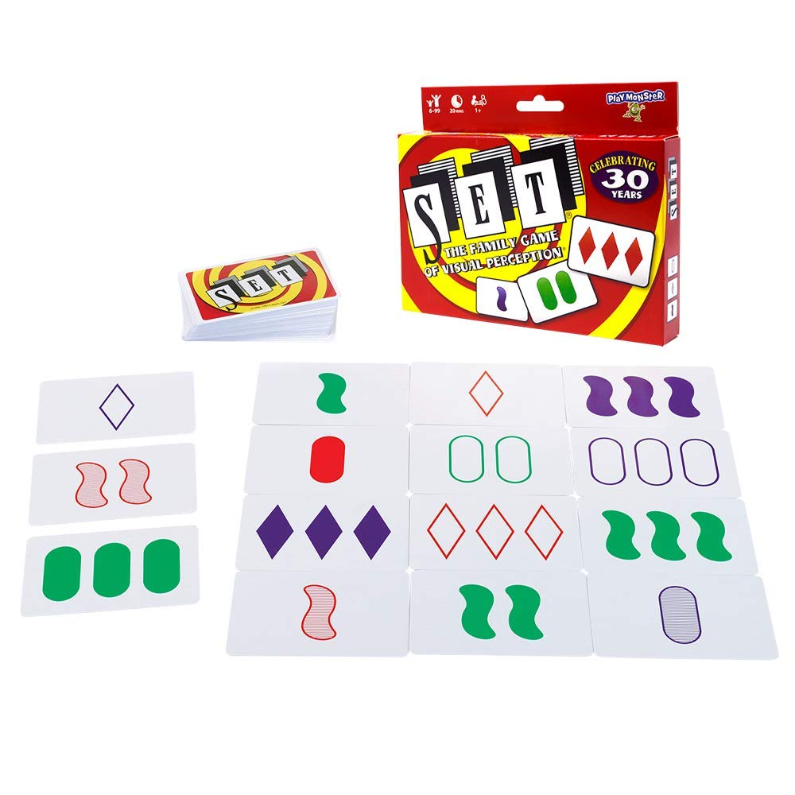
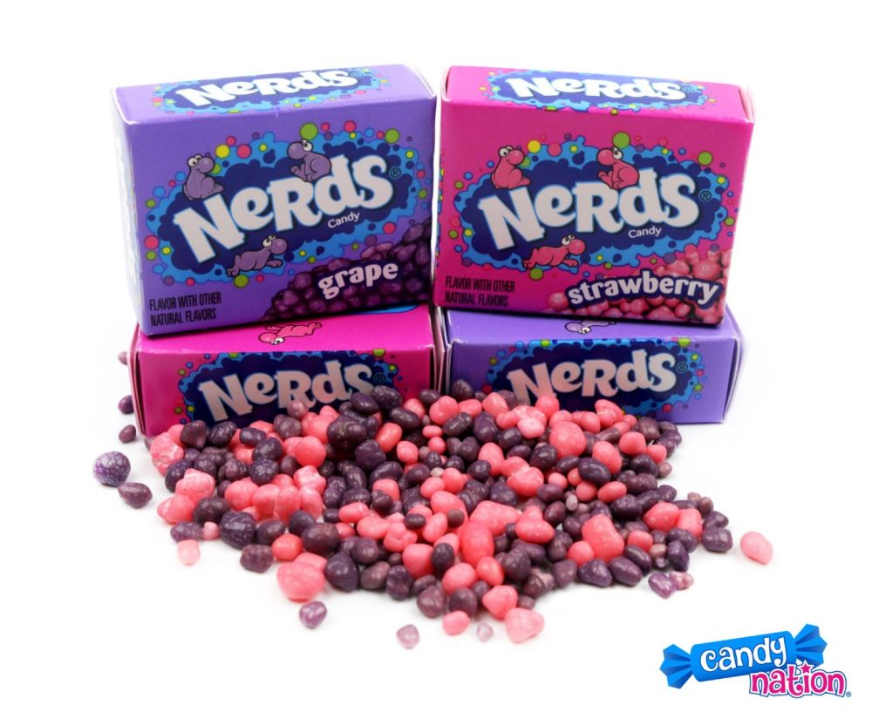
Background Information
Project motivation
When I get stressed, I tend to lack self-control in how long I spend playing games and how much candy I consume. Although these two actions seem unrelated, I realized that I could address both of these problems through Ready, Set, Candy!
Ready, Set, Candy! Proposal
Users can play one round of Set, a logic card game, per day in exchange for a predetermined portion of candy
12 cards are displayed -> user finds all 6 sets -> candy gets dispensed
https://www.setgame.com/set/puzzle <- puzzle of the day
Existing projects/libraries:
Candy Game Box: https://www.hackster.io/candy-game-box
Tap Test: https://www.hackster.io/tap-test
Improvements / additions over existing project
This project takes inspiration from Candy Game Box’s
Rules of Set:
Each card has 4 features: color, number, shape, and shading
The 3 cards in a set must display each feature as either
A) all the same
B) all different

Slide 3
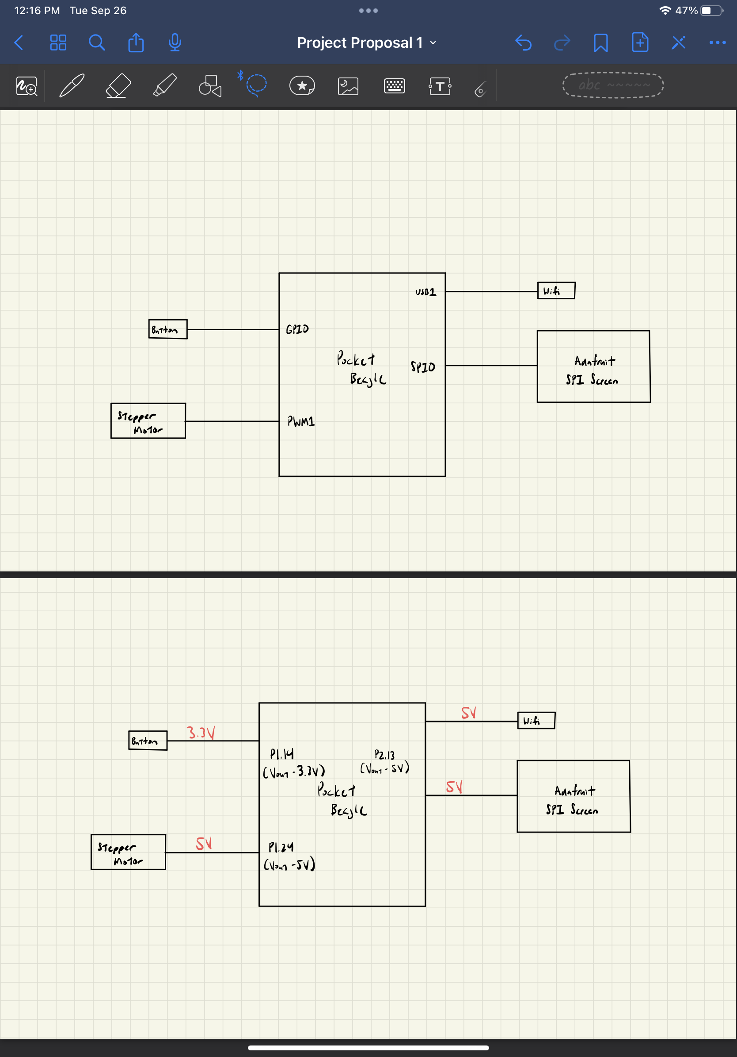
System Block Diagram

Slide 4
Power Block Diagram

Slide 5
Components / Budget
Component | Need to Buy | Cost
BeagleBoard.org PocketBeagle | No | -
Adafruit SPI Screen - 2.8" TFT LCD w/Touchscreen Breakout Board | 1 | $29.95
Amazon - USB Wifi | 1 | $9.99
Amazon - Stepper Motor | 1 | $8.99
Button (x1) | No | -
Breadboard (x1) | No | -
Resistors | No | -
Wood | No | -

